Slide 1

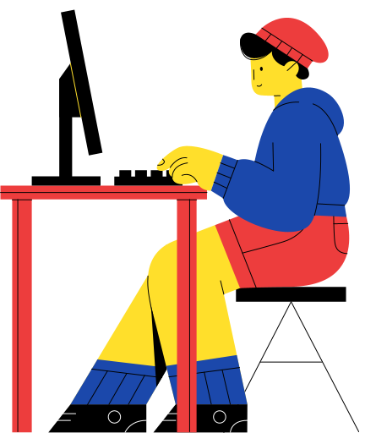
You-Snooze You-Win
Digital Age Sleep Analysis

Slide 2
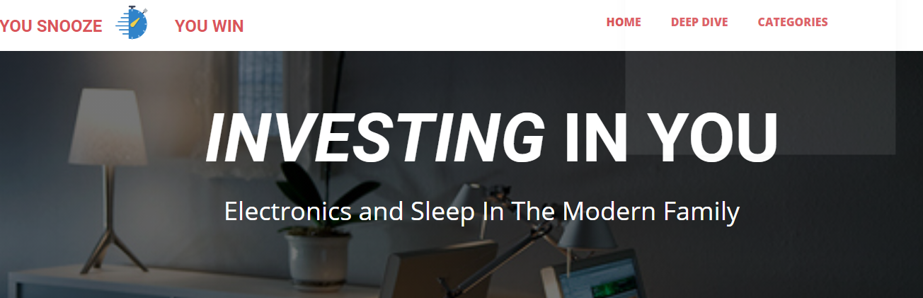
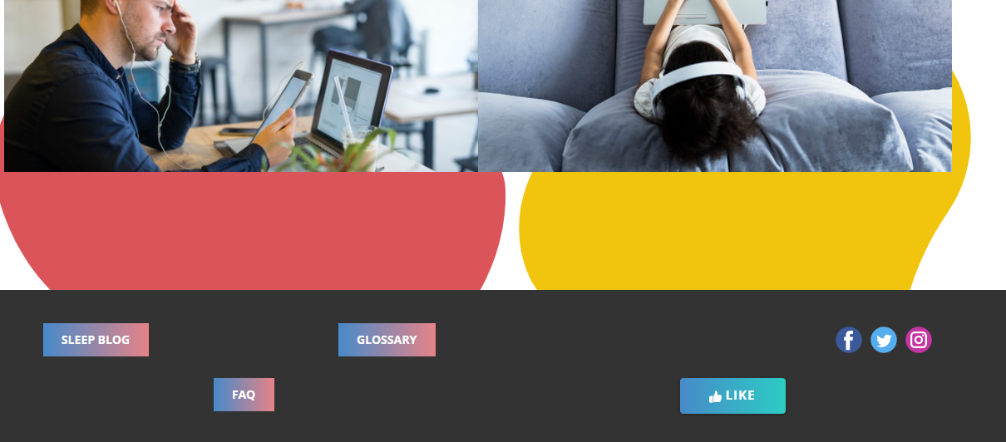
“YOUR FUTURE DEPENDS ON YOUR DREAMS, SO GO TO SLEEP.”
Contributions of the
Project
Suggestions for future research

Slide 3
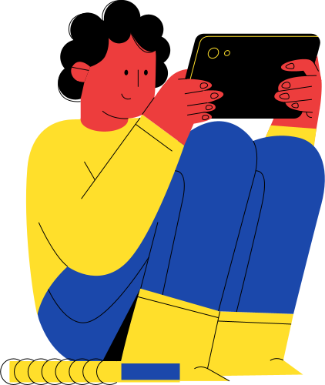
Sleep in the Modern Family
Overview of the project
NATIONAL SLEEP FOUNDATION America —
Insufficient sleep affects nearly 35% of adults , 25% of young children, and as many as 72% of high school students.
Recent studies have found that around 75% of children and 70% of adults use electronic devices in their bedroom or in bed.
Are you aware of FOMO???
Fear of missing out –
is a digital social anxiety as it results in compulsive checking for updates, messages and endless stream of activities in which any given person is not involved, believing others are have interesting life comparatively leading to negatively influence psychological health and well-being

Slide 4
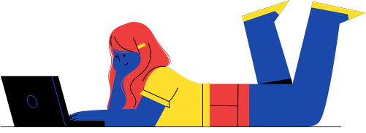
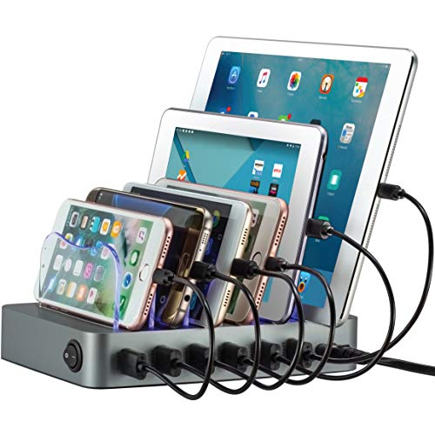
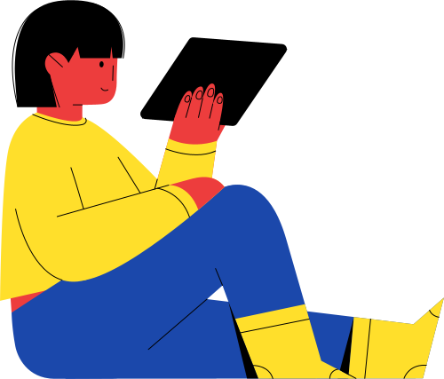
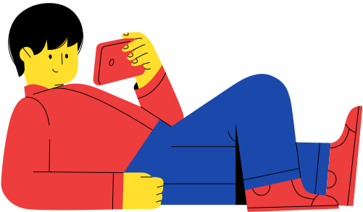
Hypothesis
Can we create a Technology-Free Bedroom?
.
Given how ingrained technology is in modern society, creating technology-free spaces may feel like a daunting task.
Tips: Don’t work in bed
Develop a new bedtime routine
Use a basic alarm clock
Consider a white noise machine
Set boundaries with friends, family, and work
Develop a new bedtime routine
Create a dedicated space for electronics
Learn relaxation techniques, least setting a good example to children.

Slide 5

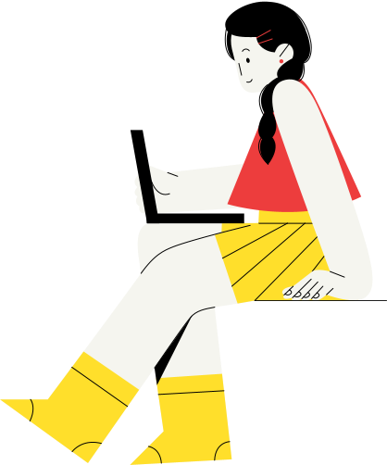

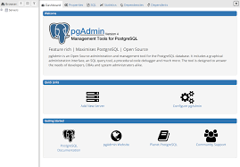

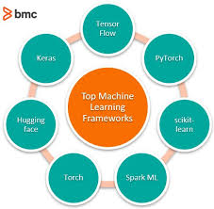


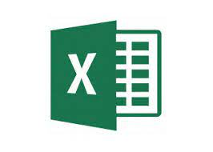
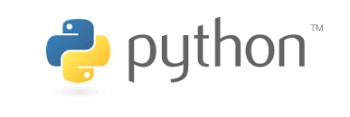
Overview of Research Methods

Slide 6
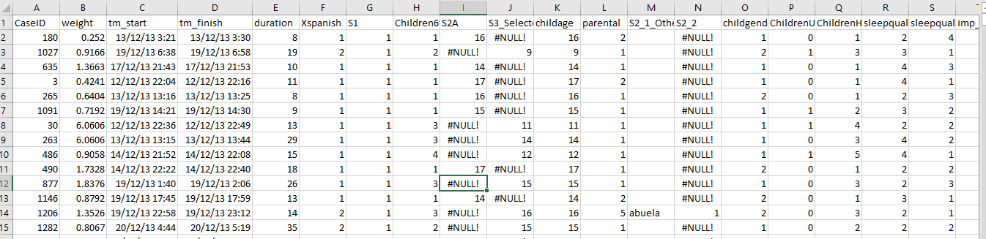
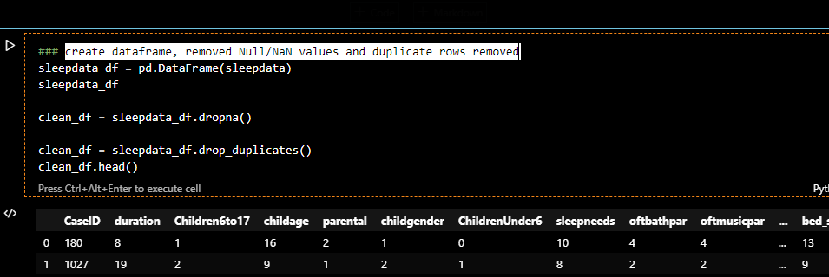
Sneak peek at the dataset
Data Cleaning
The raw data had 1104 rows and 377 columns.
Minimized to needed data and using pandas created Data Frames
Cleaned Data by removing Null/Nan Values and duplicate rows.
Now my data was filtered with age group of children of family 6 to 17, excluding children living with aunt, grandparents and solo parent.

Slide 7
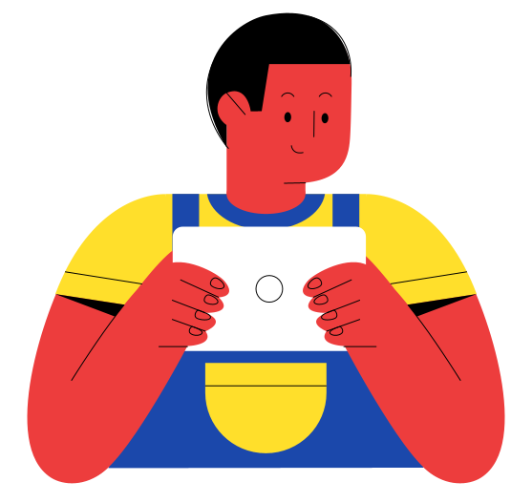
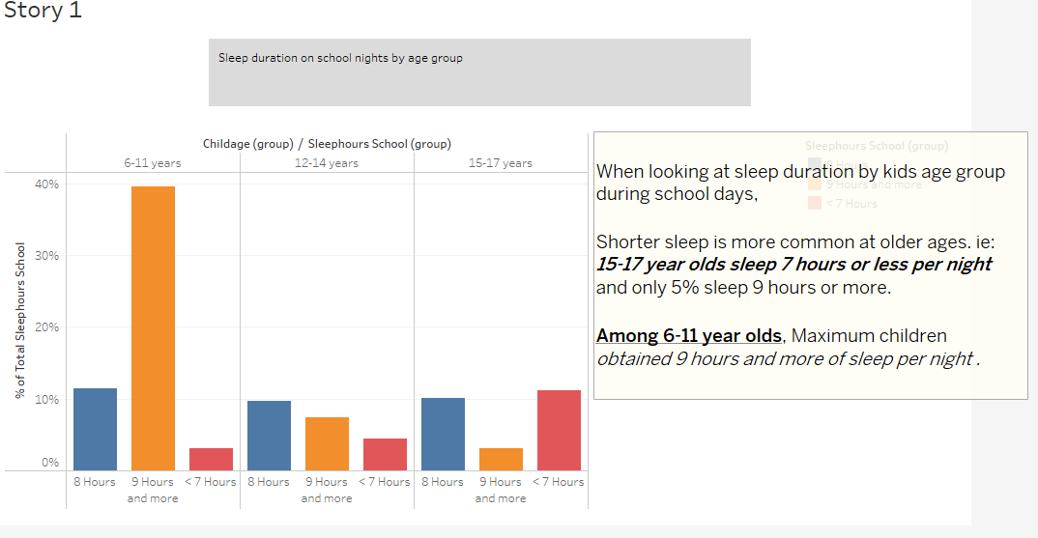
Tableau Info graph

Slide 8
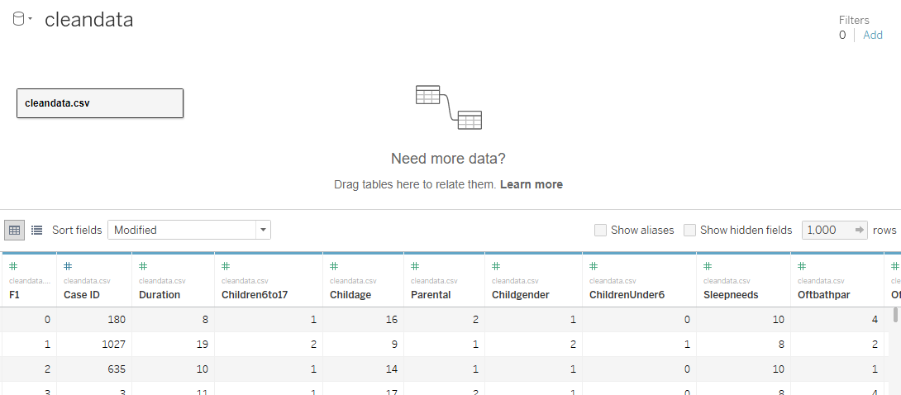
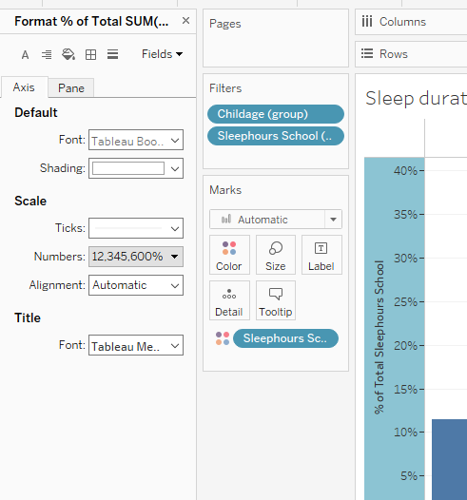
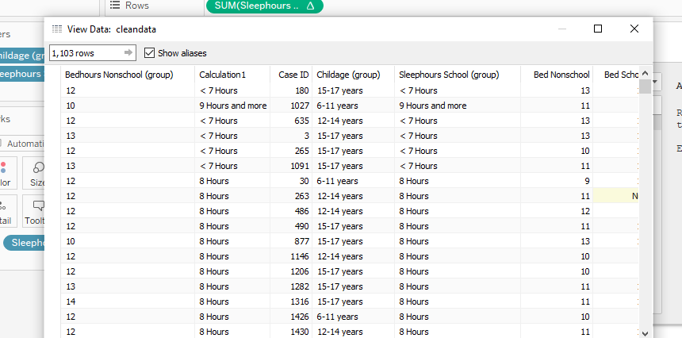
Let's see how I used the data in Tableau
Firstly, connected the data, Grouped, Calculated and formatted.
17

Slide 9
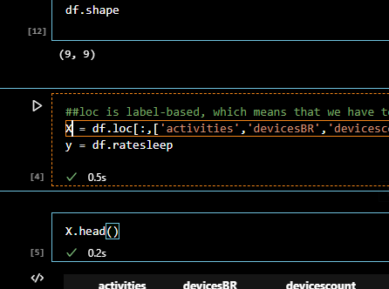
Machine Learning – EDA
Install and loaded SciPy Libraries
from pandas import read_csv
import matplotlib.pyplot as plt
from sklearn.model_selection import train_test_split
from sklearn.linear_model import LinearRegression
from sklearn.datasets import make_regression
from sklearn import tree
model = tree.DecisionTreeClassifier()
from sklearn.preprocessing import LabelEncoder
enc = LabelEncoder()
from sklearn.svm import SVC
import pickle
Import joblib
from joblib import dump
from joblib import load
Exploratory Data Analysis
Loaded and summarized the data
df.shape – check the original shape of data.
df.loc - split into input (X) and output (y) variables

Slide 10
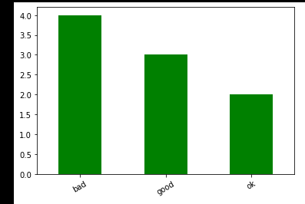
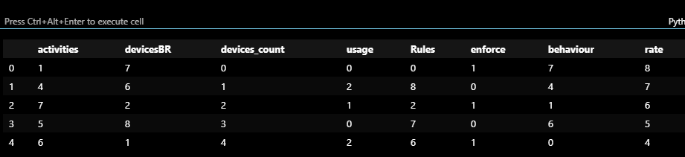
Machine Learning - Normalization
sklearn.preprocessing preprocessing.LabelEncoder()
used to transform non-numerical labels to numerical labels.
Model Fit
model = tree.DecisionTreeClassifier() and Regression
Choosing this tree because there’s a lot more flexibility to explore, plan and predict several possible outcomes to your decisions.
makes it easy to go back and edit your decision tree as new possibilities are explored.
1
“Barplot” to visualize the number of samples for each category in the target variable

Slide 11
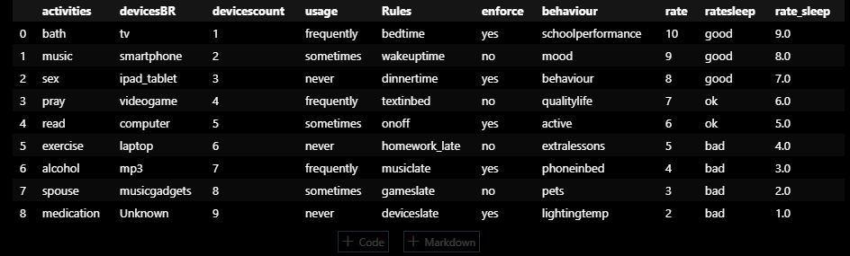
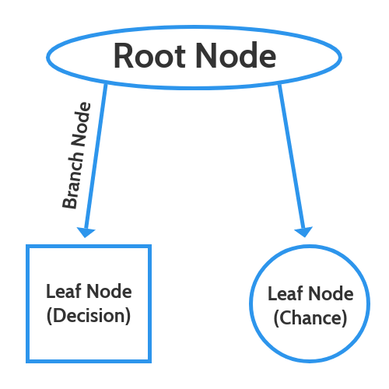
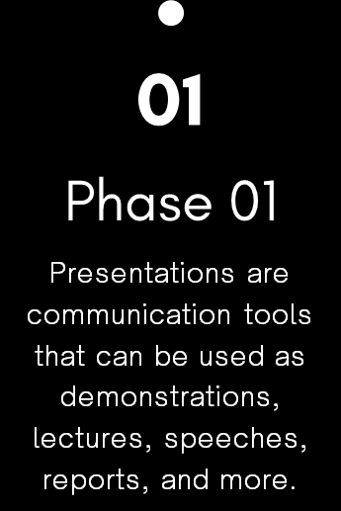
Machine Learning - Normalization
01
Phase 01
Presentations are communication tools that can be used as demonstrations, lectures, speeches, reports, and more.
Root node – big decision
square leaf nodes, which indicate another decision to be made and circle leaf nodes, which indicate a chance event or unknown outcome.

Slide 12
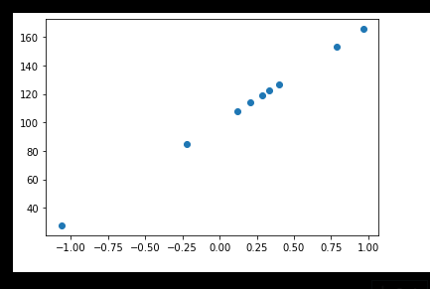
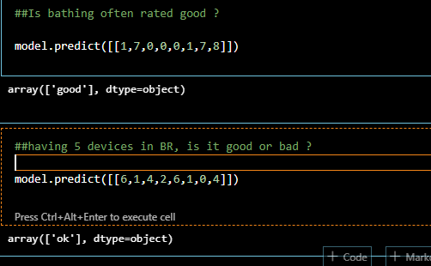
Classification and Regression Capabilities
Decision trees are compatible with both types of tasks — regression as well as classification.
Model Prediction
Finally Imported Pickle to Dump the data(save it) and Load the data back.

Slide 13
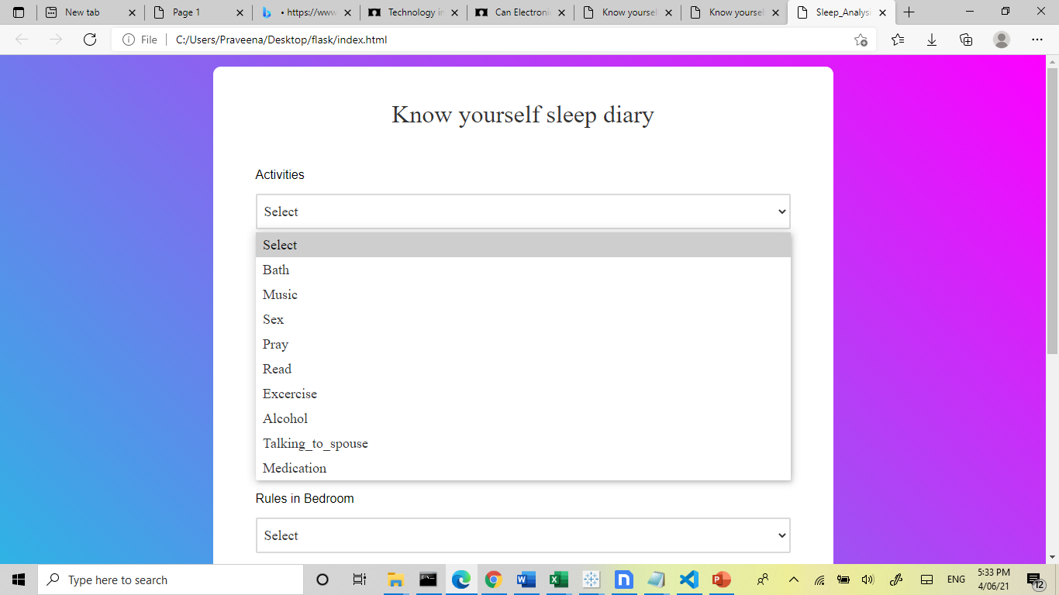
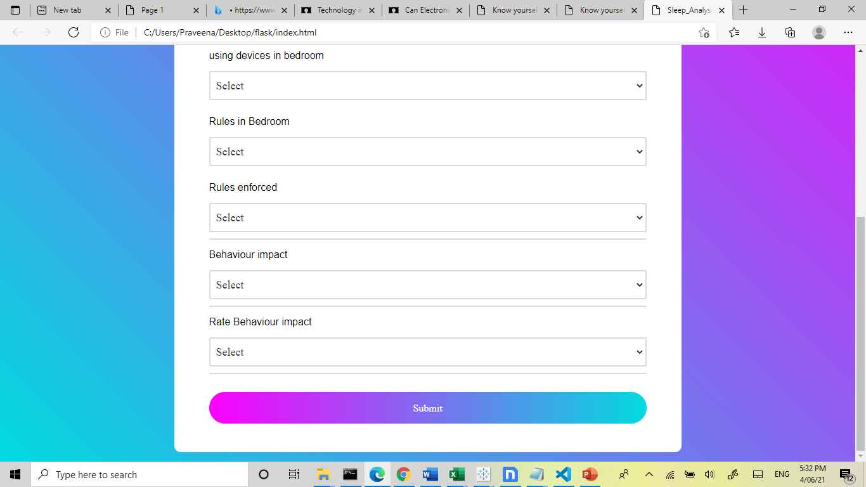
Presentations are communication tools that can be used as demonstrations, lectures, speeches, reports, and more.
Objectives
Make sure you do enough research to support your points. It’s also a good idea to pair data with visual aids like charts, graphs, or images.
What we want to achieve
06
Remember to keep your presentation easy-to-read. Avoid overloading a slide with too many words and choose a color palette that won't distract the audience

Slide 14
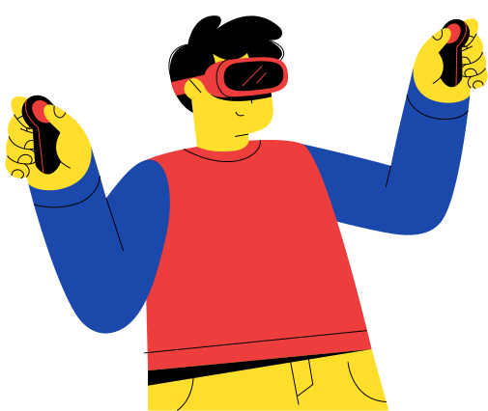
Conclusion – You-Snooze You-Win
Is a webpage where parents can invest in designing a sleep healthy home by setting boundaries
around the use of technology,
setting rules around electronics use and
setting a good example.
Visualize/Analyse:
The sleep habits of children during school days and non-school days.
Impact of parents/children having electronic device in their bedroom.
“Know yourself sleep diary” to help individual practices to help them sleep better.
17

Slide 15
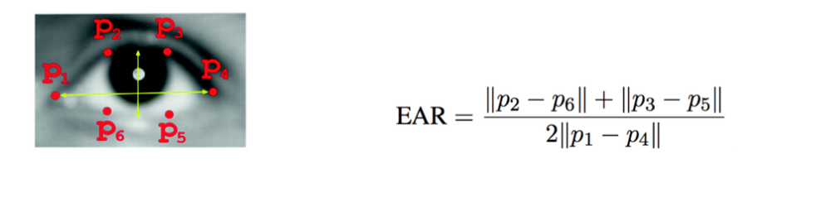
Scope in the future project :
Maintain a weekly log of routine.
Drowsiness Detection System
We can try to build a system(camera app), that detects whether a person is drowsy and advise the kid to sleep who are cheeky to be active .
Hypothesis shows that when an individual is drowsy, their eyes are likely to get smaller and they are likely to blink more.
Contributions/Sources:
https://www.sleepfoundation.org/
https://www.sleepfoundation.org/professionals/sleep-americar-polls/2014-sleep-modern-family
https://www.sleepcycle.com
https://restonic.com/blog/quotes-better-sleep-2546
14

Slide 16
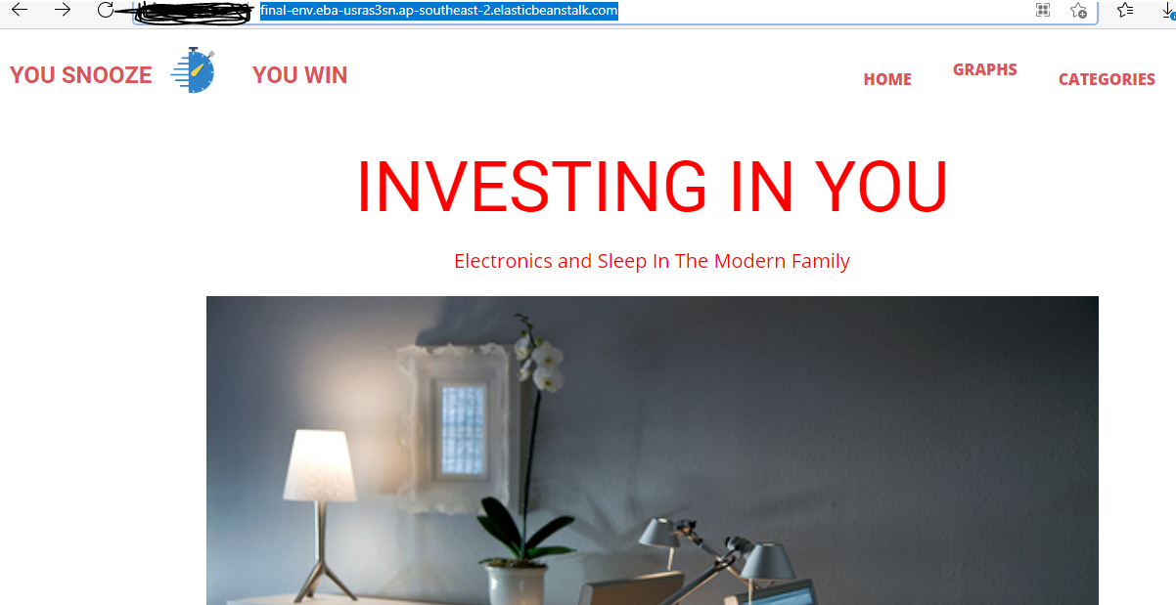
Please feel free to explore and analyze
Web URL : final-env.eba-usras3sn.ap-southeast-2.elasticbeanstalk.com

Slide 17
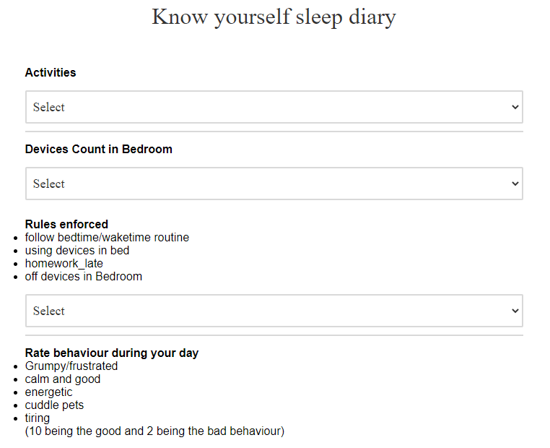

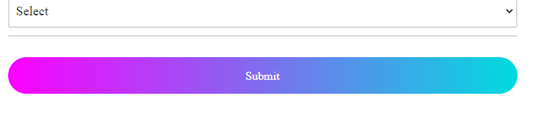
Prediction Results
Address
123 ANYWHERE ST., ANY CITY, ST 12345
Phone Number
19
123-456-7890
hello@reallygreatsite.com

Slide 18
Areas of Improvement
QUESTIONS

